Slide 1
JioGigaFiber
FTTH India 2018
Broadband Framework: Strategic Direction and Implementation

Slide 2
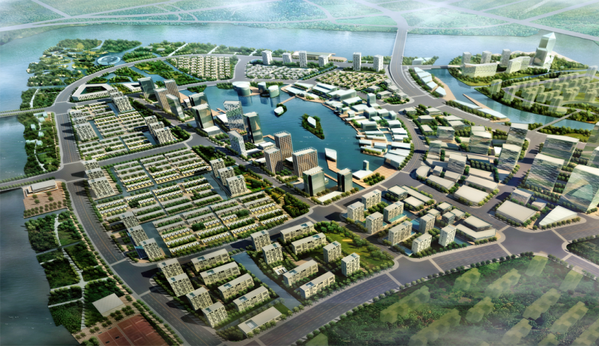









Jio GigaFiber (Home & Business)
City WiFi
Free Wi-Fi, Auto log ob, Customer Info
Safe City
CCTV, surveillance, face identification,
e-Payment
All shops support digital payment
e-Governance
10G connection, public service online
Smart Home
4KTV, Surveillance, healthcare
Become the No 1 Mobile Data and Top 5 fixed data network globally
Significant ↑ GDP p.c. (till 2020)
↑ Enterprise Growth
↓ Time in govt. affairs
↓ Crime rate
↑ Digital payment
Learning anytime and anywhere
10 Mn+ Enterprise on Fiber
50 Mn+ Homes on Fiber
Be the 1st All fiber network in India
100% FTTH coverage in 1100 Cities
1Gbps ready network
Average connection speed >100Mbps
$50 bn investment since 2012
Industrial IOT
Smart campus, smart cloud, big
data analysis
e-Environment
PMI, UV, air pollution monitoring
Surveillance
CCTV, traffic monitoring/control
e-Education
10G to campus, education cloud, remote learning

Slide 3

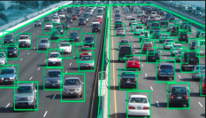











Redefining Home Broadband from Bandwidth to Experience
4K Video
drives bandwidth
10Mb -> 100Mb -> 1Gbps
BB+ WiFi+ 4K IPTV/ VR + Game
4K HDR Live Sport
Live Traffic Monitoring in
Smarty Cities
Bandwidth
VR/AR
New Use cases
100ms -> 20ms -> 10ms
E2E network
VR terminal
Latency
VR Use Cases
Gaming need lower latencies
95% Fulfilment Within 1 Day
Installation and Maintenance
Active user > 100M
body movement
4 meters per second
Experience

Slide 4







Technology & Cost comparison
Technology | Attraction to User | Revenue | CAPEX | OPEX | Future Proof
CO based xDSL(Exchange) |  |  |  |  | NA
FTT-Node (Coax, XDSL)
FTT-Building (Ethernet)
FTT-Home
Access
Brownfield Operator – Gradual Upgrade to FTTH
Greenfield Operator – Rapid FTTH Deployment
Aggregation
Residential
Core
Business
CO
Access
FTTN
FTTN
Aggregation
Core
FTTCab
Cabinet
Access
FTTB
Aggregation
Fiber
Copper
FTTH
Core
FTTH

Slide 5










Leading to Setup New Targets for Broadband
  Digital Europe
  (2020)
  Broadband China
  (2020)
  Giga Korea
  (2020)
100Mbps
1Gbps
10Gbps
( 50% )
(developed city)
(SKT)
30Mbps
50Mbps
1Gbps
(100%)
(common city)
(100%)
...
Gigabit Germany
France
Tres Haut Debit
Smart Singapore
Saudi Arab
Vision 2030
Malaysia
CMAP
Digital
Thailand

Slide 6




Broadband is bringing great socioeconomic benefits
+1.3% GDP
35% of global economic output
2.7-2.9 of benefit to cost ratio
$5 return for every $1 investment
+$322 monthly income (OECD)
+$46 monthly income (BRICS)
+2~3%
Employment
Rate
+10%
Broadband
penetration
15x
Innovation
Efficiency
+5~20%
Production
Efficiency
-5%
Gas Emission
Source：Impacts of Broadband on the Economy, ITU, 2012

Slide 7
Thanks
FTTH India 2018

